Slide 1
COMP 249:
Object Oriented Programming II
Chap 11 – Recursion

Slide 2
Recursion
the 2 most difficult concepts for new programmers are:
  Pointers
  Recursion
Java eliminates pointers ☺
You still have recursion ☹
  Difficult concept
  Can be very powerful

Slide 3
The Concept
Recursion = defining something in terms of itself
Not just in computer science…
  In linguistics / dictionary definition:
    politically : in a political way
    political : related to politics
    politics : the art or science of government
  In finance / compound interest
    money at year n = (money at year n-1) + interest
    money at year 0 = capital

Slide 4
Recursion in Programming
A method can call another method…
So a method can call itself…
mA
mB
mA

Slide 5
A Recursive Method
A well-formed recursive method must have:
At least 1 base case or terminating condition (that is not recursive)
One or more recursive cases that eventually arrive at a base case
Note:
  Recursion continues until a terminating condition is reached
  Then it backtracks
  If not reached, you get infinite recursion 

Slide 6
Factorial
In math
N! = 1 if N = 0 (base case)
N! = N x (N-1)! (recursive case)
4! = 4 x 3! 3! = 3 x 2! 2! = 2 x 1! 1! = 1 x 0! 0! = 1
In Java
public long fact(int n) {
// base case
if (n == 0)
return(1);
// recursive case
return (n * fact(n - 1));
}

Slide 7
A Simple Example
Original call
starting point
sum(3)
Step 6
return sum(3) = 6
Step 1
call sum(3)
3 + sum(2)
public int sum (int num) {
int result;
if (num == 1)
result = 1;
else
result = num + sum (num-1);
return result;
}
Step 5
return sum(2) = 3
Step 2
call sum(2)
2 + sum(1)
Step 4
return sum(1) = 1
Step 3
call sum(1)
return 1

Slide 8
Basic Design Approach
Define the logic:
  Identify a solution in terms of sub solutions -- the recursive case
  Identify the terminating condition - the base case
Write a method that implements the logic
Test, test, test!

Slide 9
Iterative Factorial
Fact(4) = 4 * 3 * 2 * 1
Fact(6) = 6 * 5 * 4 * 3 * 2 * 1
public long fact(int n) {
  long product = 1;
  for (int i=n; i>= 1; i--)
  product = i * product;
return (product);
}

Slide 10

If no base case…
public long fact(int n) {
// base case
//if (n == 0)
// return(1);
// recursive case
return (n * fact(n - 1));
}
System.out.print(fact(2));
output?

Slide 11
Fibonacci series
Fibo(1) == 1
Fibo(2) == 1
Fibo(n) = fib(n-1) + fib(n-2)
public long fibo(int n) {
}

Slide 12
Another Example
Base case:
Recursive case:
show(1234)
1
2
3
4
output
algo
public void show(int n) {
}
Java

Slide 13
What about?
public static void show(int n) {
if (n<10)
System.out.println(n);
else {
System.out.println(n%10);
show(n/10)
}
show(1234)
output?

Slide 14
Sum of elements
10 | 2 | 4 | 1
algo
public static int sum(int a[]) {
return (sum(a, a.length));
}
public static int sum(int a[], int len)
{
}
Java

Slide 15

Just checking
Given the following function, what will be the output of
System.out.println(doIt(2,4));
public static int doIt(int x, int n)
{
if(n < 0){
System.out.println("Illegal argument to power"); System.exit(0);}
if(n > 0)
return (doIt(x, n-1) * x);
else
return(1); //base case
}
2
8
16
32
Infinite loop

Slide 16
Just checking
Given the following function, what will be the output of
doIt(“nancy”,5);
public static void doSomething(String s, int size)
{
if(size >0)
{
System.out.print(s.substring(size-1, size));
doSomething (s, size-1);
}
}
nancy
ycnan
nny
ac
Infinite loop

Slide 17
Just checking
Given the following function, what will be the output of
doIt(“nancy”,5);
public static void doSomething(String s, int size)
{
if(size >0)
{
doSomething (s, size-1);
System.out.print(s.substring(size-1, size));}
}
nancy
ycnan
nny
ac
Infinite loop

Slide 18
Palindrome
Laval
Madam, I'm Adam.
public static void main(String[] args) {
System.out.println(Palindrome.isPalindrome("Madam, I'm Adam.")); // true
System.out.println(Palindrome.isPalindrome("Nope!")); // false
System.out.println(Palindrome.isPalindrome("dad")); // true
System.out.println(Palindrome.isPalindrome("Go hang a salami, I'm a
lasagna hog.")); // true
}

Slide 19
Palindrome in Java

Slide 20
Iteration vs. Recursion
Any recursive function can be re-written iteratively
But:
  Recursive version:
    Often more natural
    But inefficient (more space/time)
      why? because a new method call every time
      so? need to create/copy a new set of parameters, local variables, …
  Iterative version:
    Often more awkward
    More efficient (faster/less memory)

Slide 21
So what should I use?
For more complex problems
  recursion is much simpler and should be used
Why is it simpler?
  Recursion forces the computer/programming language to handle intermediate results
  With iteration, you must handle all of this stuff! ☹
Rule of thumb:
  If a problem can be solved with a simple iterative solution, use it.
  If the problem can be defined recursively AND the iterative solution is complex, then consider recursion.

Slide 22

Towers of Hanoi: The Legend
"At the beginning of time the priests of a Hindu temple were given a stack of 64 gold disks, each one a little smaller than the one beneath it. Their assignment was to transfer the 64 disks from one of the three poles to another, with one important provision: a large disk could never be placed on top of a smaller one. The priests worked very efficiently, day and night. When they finished their work, the myth said, the temple would crumble into dust and the world would vanish…"

Slide 23
Towers of Hanoi
Puzzle made up of:
  3 vertical pegs
  several disks of ≠ size that slide on the pegs
Initially:
  all disks are on one peg
  the largest disk on the bottom with increasingly smaller ones on top
Goal:
  move all disks from one peg to another
Rules:
  you can only move 1 disk at a time
  you cannot place a larger disk on top of a smaller one
Initial
Goal

Slide 24
Example: Towers of Hanoi
Original Configuration
Move 1
Move 2
Move 3

Slide 25
Example: Towers of Hanoi
Move 4
Move 5
Move 6
Move 7 (done)

Slide 26
Towers of Hanoi
nb disks (N) | nb moves (2^{N}-1)
1 | 1
2 | 3
3 | 7
4 | 15
5 | 31
10 | 1,023
15 | 32,767
20 | 1,048,575
64 (which ins't much…) | 18,446,744,073,709,551,615
If the priests worked day and night moving one plate per second
it would take 584 billion years !!

Slide 27
TowersOfHanoi.java
An iterative solution to the Towers of Hanoi is quite complex
A recursive solution is much shorter and more elegant
public class SolveTowers {
public static void main (String[] args) {
TowersOfHanoi towers = new TowersOfHanoi(4);
towers.solve();
}
}

Slide 28
public class TowersOfHanoi {
private int totalDisks;
public TowersOfHanoi (int disks) {
totalDisks = disks;
}
public void solve() {
moveTower(totalDisks,1,3,2); //Move disks from peg1 to peg3 using peg2
}
private void moveTower(int numDisks, int start, int end, int temp) {
if (numDisks == 1)
moveOneDisk(start, end);
else {
moveTower(numDisks-1, start, temp, end);
moveOneDisk(start, end);
moveTower(numDisks-1, temp, end, start);
}
}
private void moveOneDisk(int start, int end) {
System.out.println("Move one disk from " + start + " to " + end);
}
}

Slide 29
Binary Search (p. 668)
Task: searching a specific element in a sorted array.
  If the value is found, its index is returned
  If the value is not found, -1 is returned
Algorithm:
  look at the middle of the array
  If the value looked for == value in the middle
    then it has been found
  If the value looked for < value in the middle
    Then search the value in the first half of the array
  If the value looked for > value in the middle
    Then search the value in the second half of the array
  If the entire array has been searched without finding the value
    then it is not in the array

Slide 30
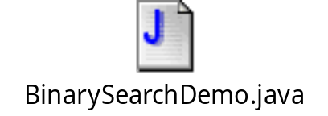

Recursive Binary Search
public static int search(int[] a, int first, int last, int key) {
int result = 0;
if (first > last)
result = -1;
else
{
int mid = (first + last)/2;
if (key == a[mid])
result = mid;
else if (key < a[mid])
result = search(a, first, mid - 1, key);
else if (key > a[mid])
result = search(a, mid + 1, last, key);
}
return result;
}

Slide 31
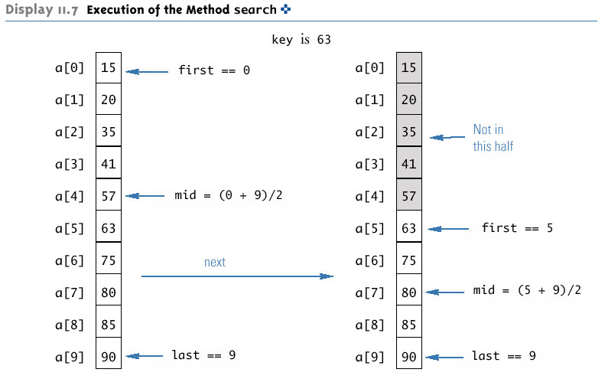
Execution

Slide 32
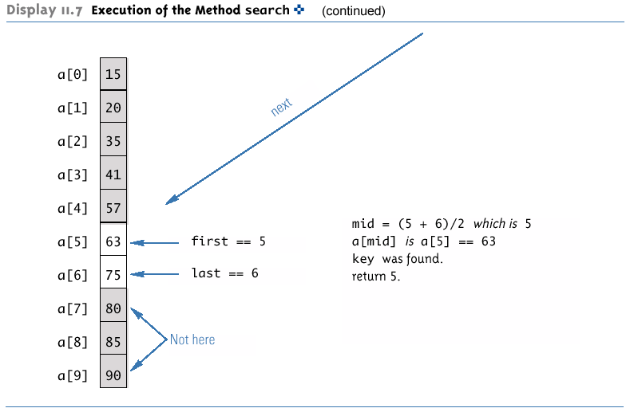
Execution

Slide 33
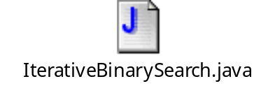
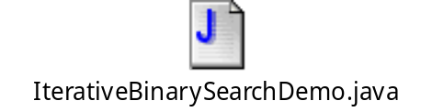
Iterative Binary Search
public static int search(int[] a, int lowEnd, int highEnd, int key) {
int first = lowEnd;
int last = highEnd;
int mid;
boolean found = false; //so far
int result = 0;
while ( (first <= last) && !(found) ) {
mid = (first + last)/2;
if (key == a[mid]) {
found = true;
result = mid;
}
else if (key < a[mid]) {
last = mid - 1;
}
else if (key > a[mid]) {
first = mid + 1;
}
}
if (first > last)
result = -1;
return result;
}

Slide 34
Cool Example
CoolMaze.java

